Slide 1

Go, change the world
RV College of
Engineering
Middleware Support for Virtualzation

Slide 2
Middleware support
For virtualization

Slide 3
INDEX
Quick Recap
Virtualization
Levels of Virtualization
Middleware support for Virtualization
Middleware
Middleware support for Virtualization
Middleware Libraries
WINE
vCUDE
Advantages

Slide 4
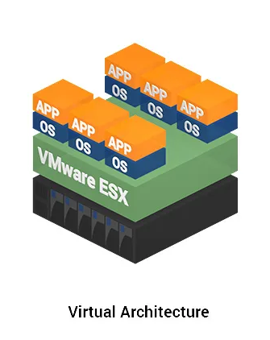
VIrtualization
Virtualization is a computer architecture technology by which multiple virtual machines (VMs) are multiplexed in the same hardware machine
VMs are the digital version of a resource, and provides functionality of a physical computer
The purpose of a VM
enhance resource sharing by many users and
improve computer performance in terms of resource utilization and application flexibility

Slide 5
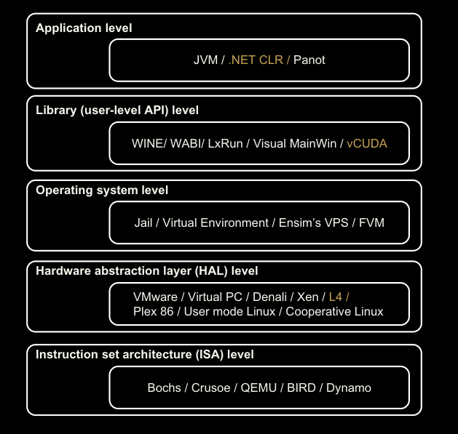
LEVELS of VIrtualization
“Virtualization layer” can be interposed at various levels of a computer system

Slide 6
3.1.4 Middleware Support
For Virtualization

Slide 7
Middleware
Middleware is software that provide common services and capabilities to applications
Middleware lies between the operating system and applications
It acts as a “software glue”, connecting applications, data, and users
The services handled (or) provided by middleware include,
Application Runtimes and Integration
Data Management
Messaging
Application Programming Interface (API) Management

Slide 8
Middleware Support for Virtualization
Library-level virtualization
User-level Application Binary Interface (ABI) or (API) emulation
Creates execution environments for running alien programs on a platform rather than creating a VM to run the entire operating system.
Alien program: Program written for Windows can be run on Linux
Platform: Linux

Slide 9
MIDDLEWARE LibrarIES
Middleware or Runtime Library | Application Platforms
WINE | A library support system for virtualizing x86 processors to run Windows applications under Linux, FreeBSD, and Solaris
Visual MainWin | A compiler support system to develop Windows applications using Visual Studio to run on Linux, Solaris and AIX hosts
vCUDA | Virtualization support for using general-purpose GPUs to run data-intensive applications under a special guest OS

Slide 10
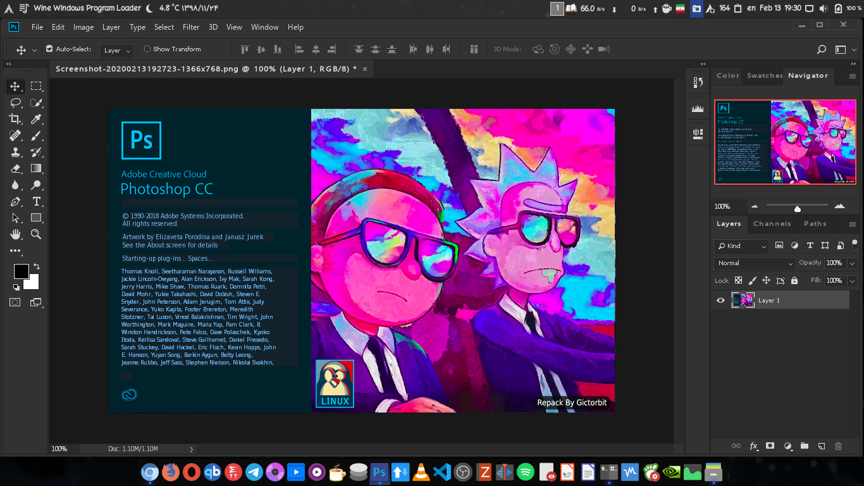
WINE
Adobe Photoshop CC running on Linux using WINE

Slide 11
WINE
Wine is a compatibility layer capable of running Windows applications on several POSIX-compliant operating systems (Linux, macOS, & BSD)
Instead of simulating internal Windows logic like a virtual machine or emulator, Wine translates Windows API calls into POSIX calls on-the-fly
API call interception and remapping are the key functions performed
Application
API Call
Middleware (WINE)
STUB
Operating System
*STUB: Procedure that translates requests from external system into a format suitable for processing

Slide 12
vCUDA
CUDA is a programming model and library for general-purpose GPUs
It is difficult to run CUDA applications on VMs directly
vCUDA virtualizes the CUDA library, and it can be installed on any OS (guest OS)
When a CUDA application is executed, vCUDA in the guest OS intercepts the call and redirects it to the CUDA library running on the host OS
CUDA Application
API Call
Middleware (vCUDA)
CUDA Library
GPU,
Device

Slide 13
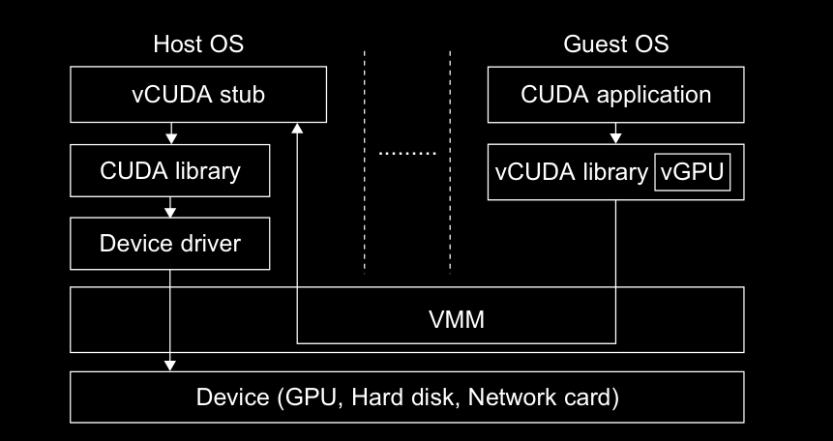
vCUDA Architecture (Client – Server Model)

Slide 14
Advantages
Doesn’t require a separate Virtual Machine to be allocated
Eliminates the performance and memory penalties
Leads to better utilization of existing computing resources
Cleanly integrates applications into your existing operating system

Slide 15
THANK YOU

